Slide 1




Fode Report
Illinois Institute Of Technology
By Sarvesh Kaushik

Slide 2



Report Outline
Illinois Institute of Technology
Use-Case Goals
Documentation of CI and HE
Analysis of CI and HE
Low Fidelity Prototype Description
Requirements
Key High Lights
TOPIC HIGHLIGHTS

Slide 3
Illinois Institute of technology
Fode is a simplified food delivery service solution exclusively integrated with the Facebook. It aspires to achieve hassle free food delivery services through it definite set of goals.
Fode provides Favourite Food List and Friends Favourite Food list in order to achieve better connection between customers. Which is not offered by all the competitors.
It Uses About section and Review section to achieve clear insights regarding Restaurants.
Preorder Feature allowing to order the food before date with New and Old Restaurant differentiator.
Live Order Tracking Use Case allows user keep track on their order on realtime basis, Only few competitors provide this feature.
Use Cases

Slide 4
Illinois Institute of Technology
Fode allows us to share the Restaurant details, Delivery Option Including Nearby Pickups indicators on the Map.
Facebook Pay unique integration with Fode allows user to choose Facebook starts as a discounted perk providing additional benefits.
Activities Section will allow user to keep track of their previous transactions.
Redesigned order and contact Information section increasing Usability by placing it on the front interface of Facebook Pay.
Curbside pickup indicators helping customers to identify the curbside pickup locations
Use Cases

Slide 5
Illinois Institute of Technology
After performing Contextual Inquiry with GrubHub Application user description and responses.
Ryan Found to be very confident while using this app. User was assigned a task to order his dinner from an online food ordering app. The online application we worked with was Grubhub.
• To start ordering on Grubhub User quickly SignedUp inside the app using his google account and went on exploring every other feature without any hassle.
• After Signing In he compared the restaurants by using ratings and prices. During searching a restaurant on the search Map he faced a little problem at one moment he accidentally exited out of the app. He tried to login inside the app. Once he was inside he tried to search for Restaurants but accidentally clicked on the wrong suggestion. At the time of login he always visit account section and cick on login button, he noticed that login icon was placed in between help and about section.
• User Successfully tracked every order by identifying the app's Orders Menu. It was easy to find the Help inside the App by quickly visiting the accounts section for him without any delay
CI

Slide 6
Illinois Institute of Technology
After performing Contextual Inquiry with Low Fidelity Prototype user description and responses.
Ryan found the newly designed interface very convenient while using this app. User was assigned a task to order his dinner from Fode.
• To start ordering on Fode User quickly logged in to facebook and went on exploring every other feature without any hassle.
• After Signing In he compared the restaurants by using ratings and prices. During searching a restaurant he get to know amazing feature of Fode allowing him to connect with his friends and see their favourite dishes and favourite restaurants. He tried to place the order and at the order placing he was able to get additional discounts in the form of Facebook Stars.
• User Successfully tracked every order by identifying the app's Orders Menu. It was easy to find the Help inside the App by quickly visiting the accounts section for him without any delay
CI

Slide 7
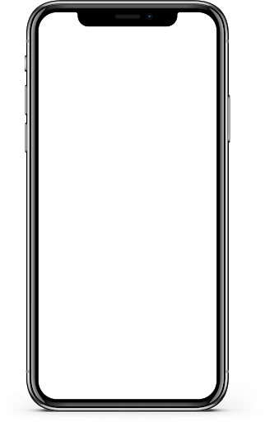
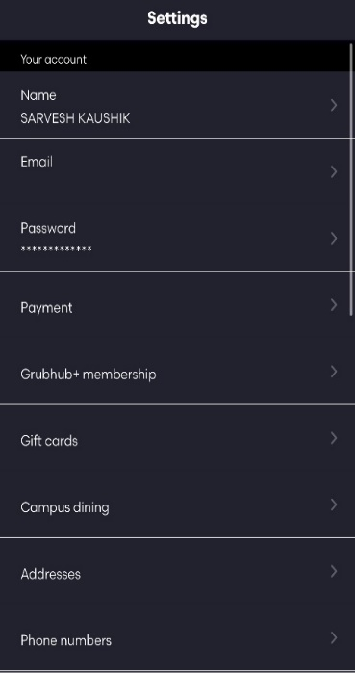
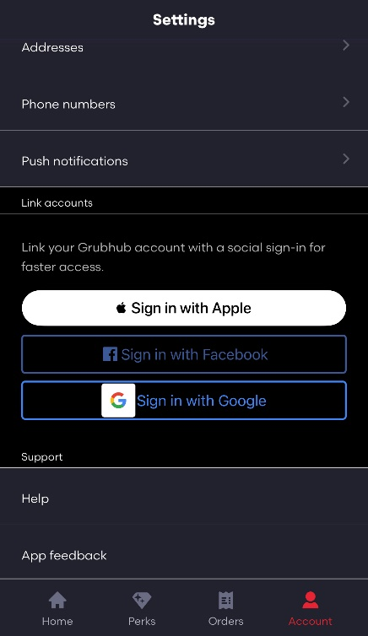
HE
According to the Heuristic Evaluation on the GrubHub Application there were two significant problems that came into existence.
Problem 1: Inconsistent layout
Reason: The settings Tab in the GrubHub Application contains unnecessary format changes.
Solution: While using Facebook Integration
Login will be done through the Facebook default login.

Slide 8
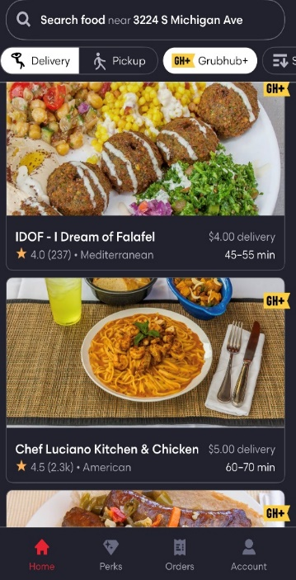
HE
Problem 2: No Favourite List
Reason: Ordering previously ordered dish could cause extra overhead incursion for the users as they have to go through order history and manually search for the dish name and the date.
Solution: Provide a Favourite List Feature.

Slide 9
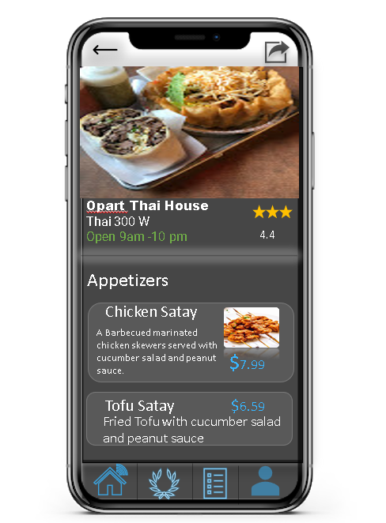
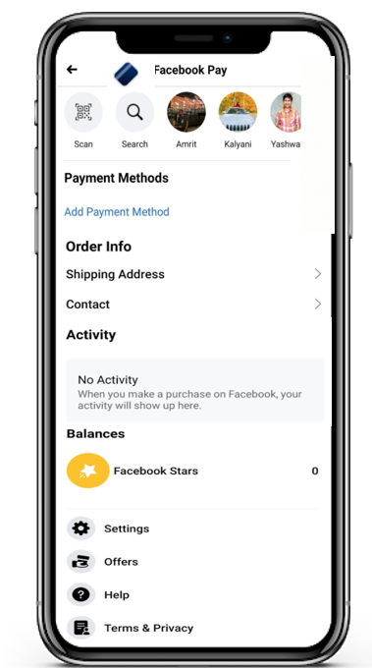
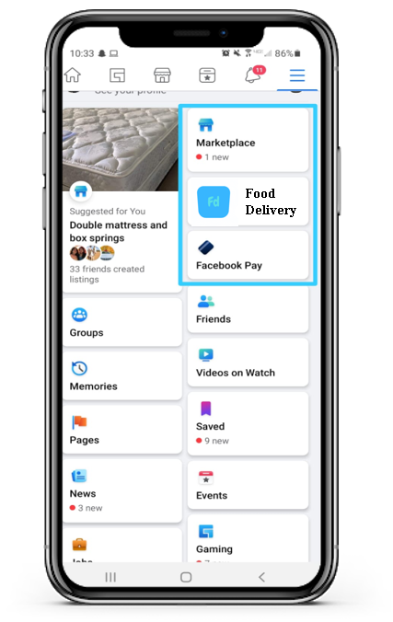
Illinois Institute of Technology
According to the Heuristic Evaluation on the Low Fidelity Prototype,
Cosisntency and Standard: It can be clearing seen that Low Fidelity prototype successfully implemented consistency in the user Design while increasing the overall Usability
HE

Slide 10
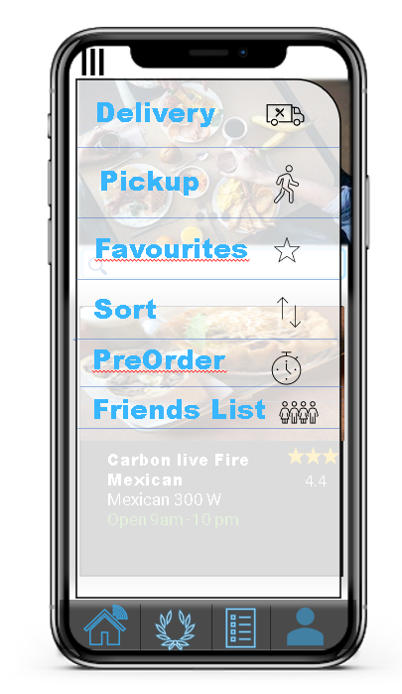
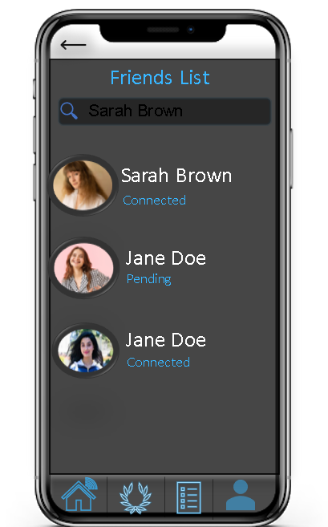
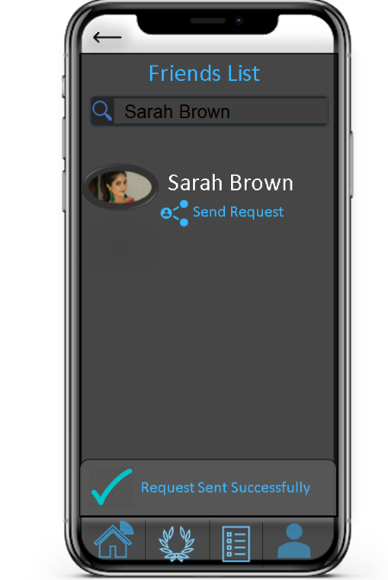
Illinois Institute of Technology
Low Fiedelity prototype addressed problem of Favourite lists and Provided Friends list where user can view their friends favouite dishes and restaurants.
HE

Slide 11

Data Flow Model 1
GrubHub Application
IOS
Placing Order(2:47)
Searching for specific food items
(0:35)(0:38)
Automatically got kicked out of the application
(1:49)
Traverse through Restaurants list
(0:32)
Searching for GrubHub Application
(1:51)
Checking perks related to the item
(0:45)(0:49)
Adding orders to the Bag
(2:05)(2:44)
Searching for a restaurant location
(1:42)
On the Restaurants menu
(1:53)
Searches
(0:34)
User

Slide 12
Data Flow Model 2
DoorDash Application
Placing Order(1:47)
DoorDash Pay
Searching for specific food items
(0:28)(0:38)
Traverse through Restaurants list
(0:22)
Checking perks related to the item
(0:40)(0:49)
Cannot Change Default payment(2:46)(2:56)
Adding orders to the Bag
(2:10)(2:44)
Searching for a restaurant location
(1:10)
Searches
(0:34)
User

Slide 13
Data Flow Model 3
Doordash Application
Placing Order(1:30)
Searching for specific food items
(0:20)(0:30)
Traverse through Restaurants list
(0:10)
Delivery
Checking perks related to the item
(0:43)(0:50)
Adding orders to the Bag
(2:00)(2:10)
Searching for a restaurant location
(1:05)
Searches
(0:34)
No direct way to pinpoint exact position of order package
(2:12)(2:20)
User

Slide 14
Illinois Institute of Technology
Low Fidelity Prototype of Fode consist of all the functionality of an Online Food Delivery Application. It provided existing Facebook users to bring their community experience on the next level. Fode leverage the Facebook friends idea and convert it into food connection idea among the friends.
With the help of Unique Friends list feature food is the only Food ordering app that allows you to see your friends interest and their liked menu items.
Fode maintain consistency and integrity in it’s design when user explore and interact with the different parts of the application.
Low Fidelity Prototype

Slide 15
Illinois Institute of Technology
As we have seen from the Heuristic Analysis it was clear that there is a need of robust food delivery system which is crash proof and address the individual Users interests.
Fode’s basic design model was capable of satisfying all the necessary requirements that came forward HE.
Requirement 1: The first and foremost requirement of inclusion of the friends list in order increase friends reach by knowing their food interests was satiated by Fode.
Fode Used the connect and request frame work based on which only existing friends on the Facebook can send you the connection request through the fode application And after a successful connection both parties can see each others food interests.
Requirements

Slide 16
Illinois Institute of Technology
Requirement 2: Fode has solve the User Interface consistency problem by proving order info and contact info right on the first interface of the Facebook Pay section.
Where as, Previously user had to go to the settings tab of the Facebook and from there he had to select order info and contact info separately.
By maintaining Consistency in the design Fode is responsible for increasing the overall usability of the application.
Requirements

Slide 17
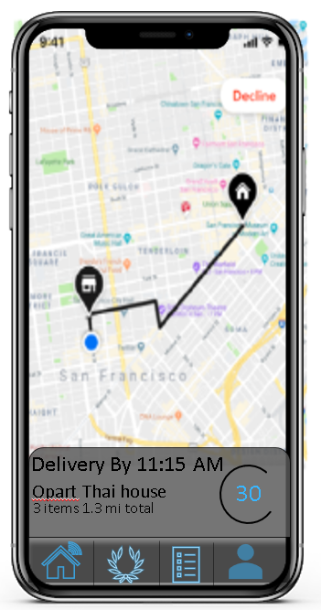
Illinois Institute of Technology
Requirement 3: Most of the Food Ordering applications such as GrubHub do not provide the live tracking service feature which tells the customers about exact location of their order.
Fode has closely monitored this problem and has come up with the accurate solution based on Live tracking update status. Which lets user know exact location of their driver while waiting.
Requirements

Slide 18



Friends List
Connecting Friends Further
Redesigned Facebook Pay Interface
Increasing the Usability of the overall application.
Live Order Tracking
Knowing exact location of delivery personnel
Key Highlights

